Slide 1



HANDWRITTEN DIGIT RECOGNITION
USING CNN
GUIDE : Ms. A. NAVYA SRI
MEMBERS :
V.ALEKHYA (121710308058)
P.AJAY KUMAR REDDY (121710308037)
K.SUMANTH (121710308021)
S.AKHIL VARMA (121710308046)

Slide 2
CONTENTS:
ABSTRACT
INTRODUCTION
PROBLEM STATEMENT
DIGIT RECOGNITION SYSTEM
METHODOLOGY
CONCLUSION
IMPLEMENTATION
FLOW CHART

Slide 3
ABSTRACT
Handwritten digit recognition is gaining a huge demand in the branch of computer vision. We are going to implement a better and accurate approach to perceive and foresee manually written digits from 0 to 9. A class of multilayer sustain forward system called Convolutional network is taken into consideration.
The digits are passed into input layers and then into the hidden layers which contain convolutional, activation and pooling layers. Then finally it is mapped onto the fully connected layer and later it is classified into digits. We are going to implement this network using keras deep learning inbuilt python library.

Slide 4
INTRODUCTION
In our half of the globe of our mind contains millions of neurons with billions of connections between them. In similar way the neural network layers consists of neurons.
The architecture of neural networks is divided into three categories , the input layer, the output layer, the layers in between input and output layer called as hidden layers.
The input layer of our network consists of input neurons encoding the values taken from input pixels of our handwritten digit.
The second layer of our network will be the hidden layer and it takes the aggregated output of first layer and applies activation function to detect the pattern of input images.

Slide 5

Next coming to output layer of our network contains 10 neurons, each neuron if fired gives any output between 0 to 9.
So this is the basic working of neural networks for an image. Similar to those of artificial neural networks but with a small modification comes Deep learning networks also termed as Convolutional networks with a higher degree of accuracy for classification.
With the use of deep learning and machine learning, human effort can be reduced in recognizing, learning, predictions and many more areas. This project presents recognizing the handwritten digits (0 to 9) from the famous MNIST dataset, using convolution neural network

Slide 6

PROBLEM STATEMENT
The handwritten digits are not always of the same size, width, orientation and justified to margins as they differ from writing of person to person, so the general problem would be while classifying the digits due to the similarity between digits such as 1 and 7, 5 and 6, 3 and 8, 2 and 5, 2 and 7, etc.
This problem is faced more when many people write a single digit with a variety of different handwritings.
Lastly, the uniqueness and variety in the handwriting of different individuals also influence the formation and appearance of the digits.

Slide 7
DIGIT RECOGNITION SYSTEM
Digit recognition system is the working of a machine to train itself or recognizing the digits from different sources like emails, bank cheque, papers, images, etc. and in different real-world scenarios for online handwriting recognition on computer tablets or system, recognize number plates of vehicles, processing bank cheque amounts, numeric entries in forms filled up by hand and so on.

Slide 8
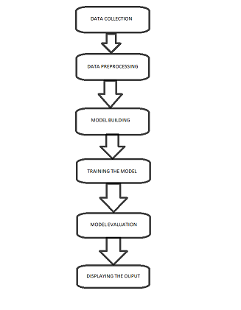
FLOW CHART

Slide 9
In this project, We are going to implement Convolutional neural networks in PYTHON. In our implementation we will be using python because we have our keras deep learning library built in python.
So by using keras models we can implement our network and create a driver program to call the network to take inputs from the data set.
The driver program also has learning algorithm ,training and testing datasets. Here we have used MNIST dataset.
METHODOLOGY

Slide 10
MNIST DATASET
Samples provided from MNIST (Modified National Institute of Standards and Technology) dataset includes handwritten digits total of 70,000 images consisting of 60,000 examples in training set and 10,000 examples in testing set, both with labeled images from 10 digits (0 to 9).
Handwritten digits are images in the form of 28*28 gray scale intensities of images representing an image along with the first column to be a label (0 to 9) for every image.
Yann Lecun, Corinna Cortes, and Christopher Burges developed this MNIST dataset for evaluating and improving machine learning models on the handwritten digit classification problem.

Slide 11
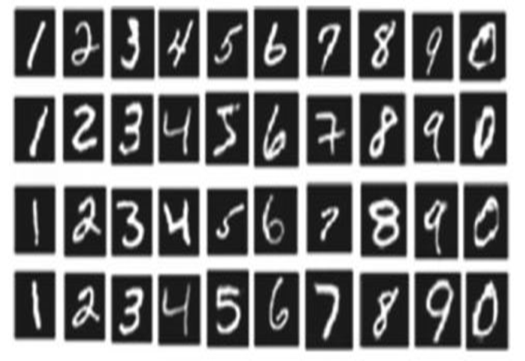
Digits present in dataset

Slide 12
CONVOLUTIONAL NEURAL NETWORK(CNN)
CNN has become famous among the recent times. CNN is part of deep, feed forward artificial neural networks that can perform a variety of 10 task with even better time and accuracy than other classifiers, in different applications of image and video recognition, recommender system and natural language processing.

Slide 13
Convolutional neural network is a class of deep neural networks, most commonly applied to analyzing visual imagery.
Use of CNN have spread as Facebook uses neural nets for their automatic tagging algorithms, google for photo search Amazon for their product recommendations, Pinterest for their home feed personalization and Instagram for search infrastructure.
Image classification or object recognition is a problem in passing an image as a parameter and predicting whether a condition is satisfied or not or the probability or most satisfying condition for an image. We are able to quickly recognize patterns, generalize from previous information and knowledge.

Slide 14
LAYERS OF CONVOLUTIONAL NEURAL NETWORK:
The multiple occurring of these layers shows how deep our network .There are three layers input layer , hidden layer , output layer.
In the hidden layer there are multiple layers they are:
Input: raw pixel values are provided as input.
Convolutional layer: Input layers translates the results of neuron layer. There is need to specify the filter to be used. The output of the one layer will be given as the input of the next layer
Rectified linear unit [ReLU] : provided activation function on the data taken as an image.

Slide 15
Pooling layer: pooling layers are used to reduce the dimensions of the feature maps.
Fully connected layer: The results of the process will feed into this layer. score class is focused, and a maximum score of the input digits is found. As we go deeper and deeper in the layers, the complexity is increased a lot. But it might worth going as accuracy may increase but unfortunately, time consumption also increases.
Softmax classifier: It returns the probabilities of all the output classes. It is used for the normalization of the output.

Slide 16
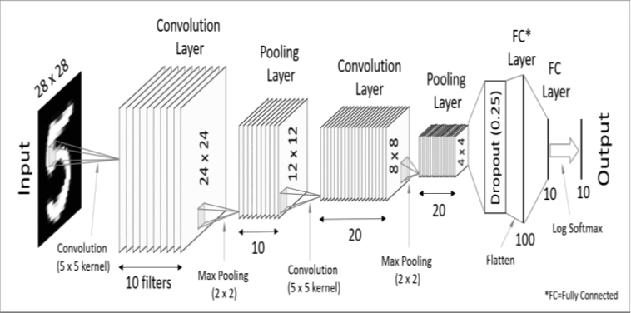
CNN architecture

Slide 17

IMPLEMENTATION

Slide 18
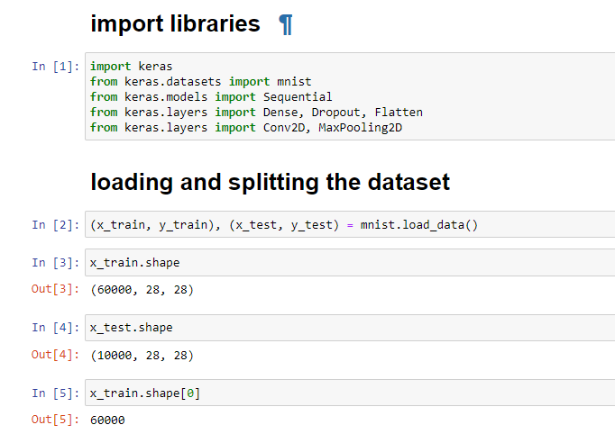
IMPORTING LIBRARIES AND DATASET

Slide 19
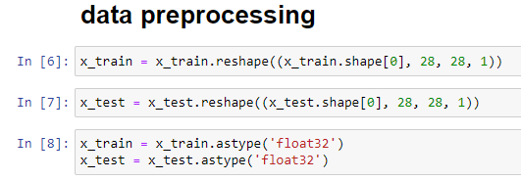
DATA PREPROCESSING

Slide 20
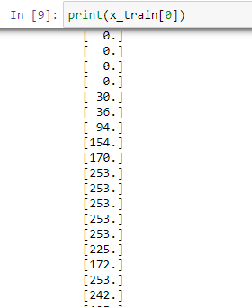
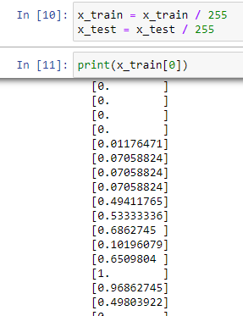

Slide 21
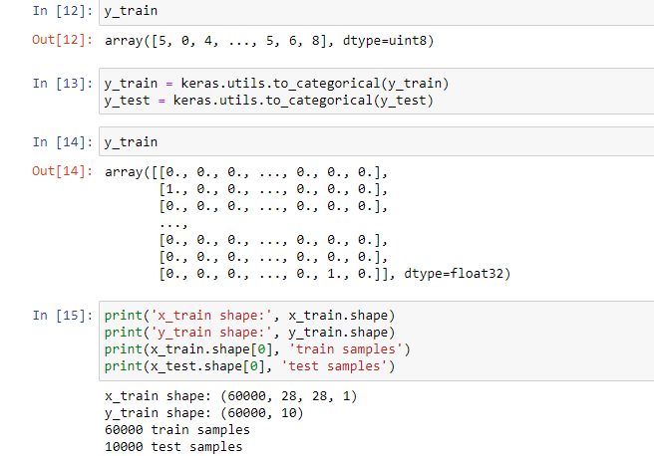

Slide 22
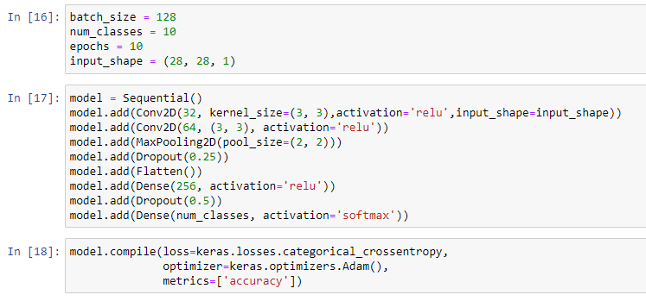
MODEL BUILDING:

Slide 23
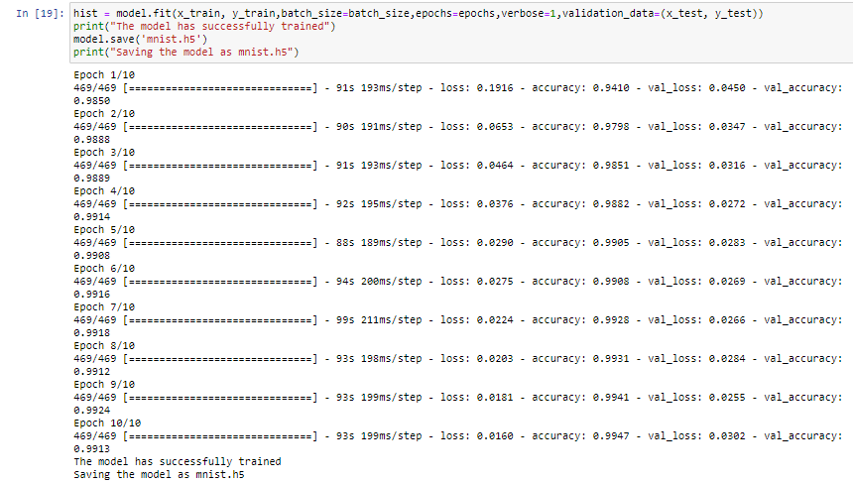

Slide 24
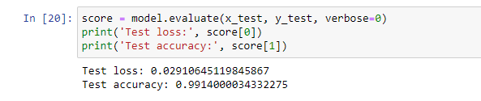
MODEL EVALUATION:

Slide 25
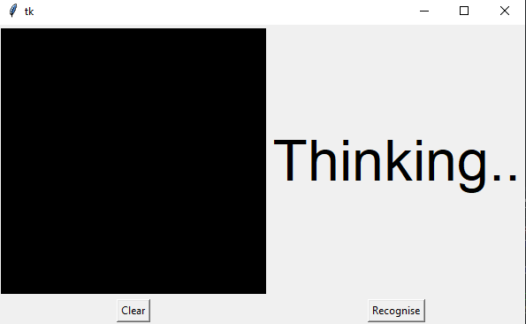
WEB APPLICATION

Slide 26
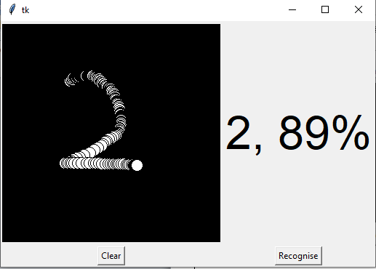
ON ENTERING DIGIT AND CLICKING RECOGNIZE

Slide 27
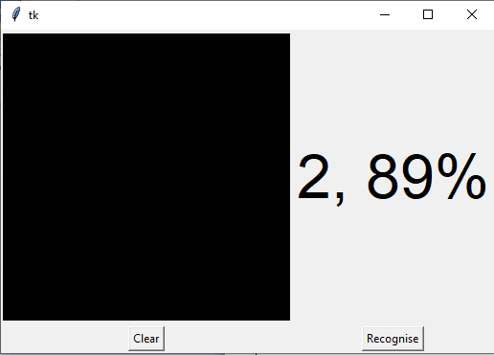
ON CLICKING CLEAR

Slide 28
CONCLUSION
In this project we are able to convert Handwritten digits into standard form digits with the help of a model which was implemented using Convolutional neural networks algorithm and the model was trained using MNIST dataset which consists of 70,000 images (60,000 images for training and 10,000 for testing process) in it.

Slide 29
THANK YOU

